Slide 1





CHARGERHEX
THE REVOLUTIONARY CHARGER

Slide 2

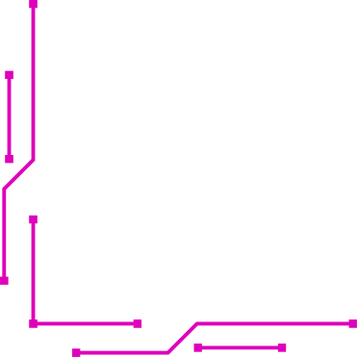
WHAT ARE WE BUILDING?
A circuit that drains the phone’s battery by consuming power.
Measures the battery drain in real-time with an Arduino Uno.
Displays the voltage on a computer using the Serial Monitor.

Slide 3
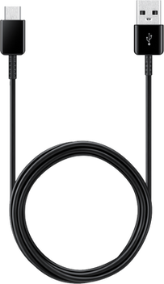
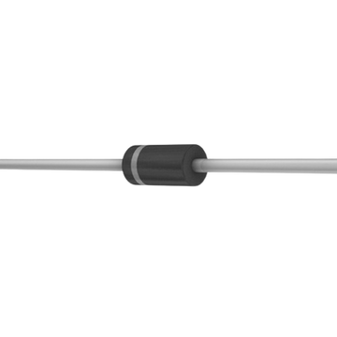
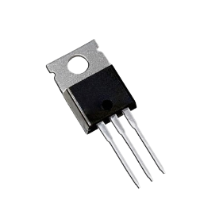
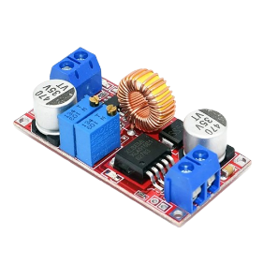
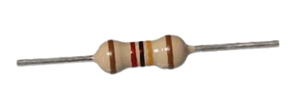
KEY COMPONENTS
USB CABLE A TO C
SCHOTTKY DIODE (1N5819)
RESISTORS
MOSFET (IRLB4132)
VOLTAGE REGULATOR (XL4015)

Slide 4
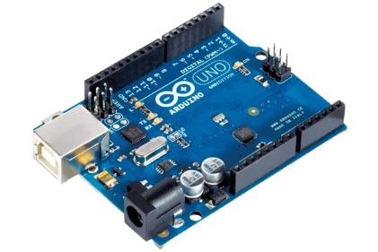
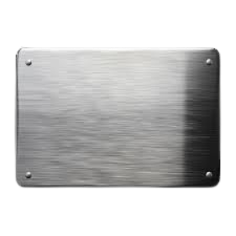
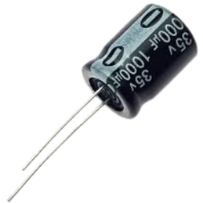
KEY COMPONENTS
CAPACITOR (1000ΜF, 10V)
ARDUINO UNO
THIN METAL PLATE

Slide 5

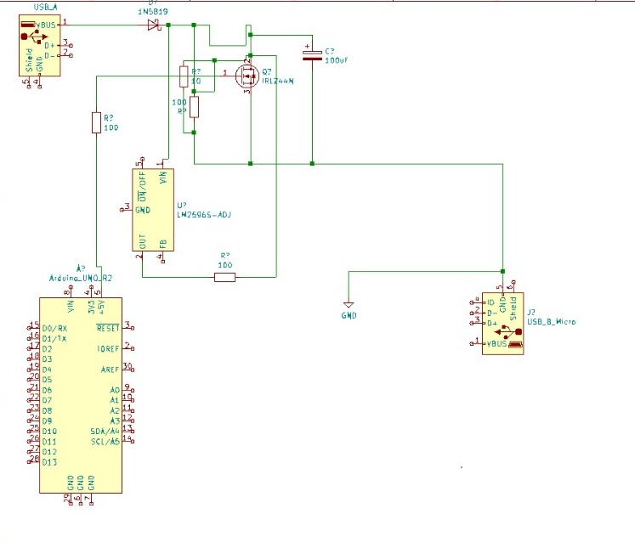
HOW DOES THE CIRCUIT WORK?
Drain the Battery: Power resistors and a MOSFET act to drain the phone's battery.
Monitor Voltage: Arduino measures and displays USB voltage on the Serial Monitor.
Ghost Touch Effect: A metal plate creates electromagnetic interference, causing random screen touches.

Slide 6

Preparing the USB Cable
Connect the Schottky Diode
Add Power Drain Resistors
STEPS OF CHARGER HEX
MOSFET to Control Power
Voltage Regulation & Capacitor
Add the Ghost Touch Plate
Arduino Monitoring and Connections
How the Circuit Works
KiCad Schematic & PCB Design

Slide 7
Power flows from the USB-A connector to the Schottky Diode.
How It Works – Battery Draining
the Schottky Diode connects to the MOSFET to manage power flow.
Resistors burn extra energy to drain the battery quickly.
The Voltage Regulator creates unstable voltage, confusing the phone’s charging system
Arduino monitors the battery and adjusts the drain

Slide 8
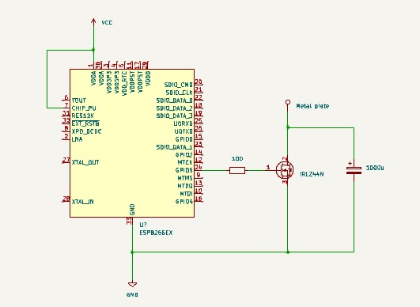
How It Works – Ghost Touch
ESP8266 powers up and sends signals.
The MOSFET is activated to control the metal plate.
The metal plate creates interference, tricking the phone into thinking it's being touched.
The capacitor boosts the effect for stronger interference.
Control ghost touch remotely via Wi-Fi by accessing the ESP8266's IP.

Slide 9
Battery Draining:
Quickly drains the phone's battery.
Measures how much battery is lost in real-time.
What Do We Achieve?
ghost Touch:
Controls the phone remotely.
Simulates random touch events.

Slide 10
Why Is This Useless?
It drains the battery super fast. But in reality, who wants their phone battery drained on purpose? Not exactly a feature anyone would want in a real phone!
imagine your phone typing messages by itself or opening apps on its own. That’s the last thing you need when you’re trying to get work done or navigate a phone!

Slide 11

Conclusion
We’re draining batteries on purpose. Who needs that?
We’re making phones think they’re being touched when they’re not. Why would anyone want that?

Slide 12

THANK
YOU

